Slide 1
ECE3403 - Data Analytics & Optimization
Section 3
Exploratory Data Analysis
TAs
Hoda Osama
Marwan Nour
Yasmina Ayman

Slide 2
Exploratory data analysis (EDA)
is a 1st step in analyzing the data from an experiment.
Types of analysis:
univariate/multivariate non-graphical.
univariate/multivariate non-graphical.
Univariate methods consider one variable at a time, while multivariate methods look at two or more variables at a time to explore relationships.
Non-graphical methods: calculation of summary statistics; graphical methods summarize the data in a diagrammatic way.

Slide 3
01.
Univariate non-graphical EDA
focuses on understanding the distribution of a single variable within a dataset.

Slide 4
Data
Categorical | Quantitative
The range of values and the frequency of occurrence for each value | (discrete and continuous data)
tabulation of the frequency of each category | Make preliminary assessments about the population distribution using the data of the observed sample.

Slide 5
Frequency Tabulation
Frequency tabulation is the process of counting occurrences of each category within a categorical variable, providing a clear overview of the data distribution.

Slide 6
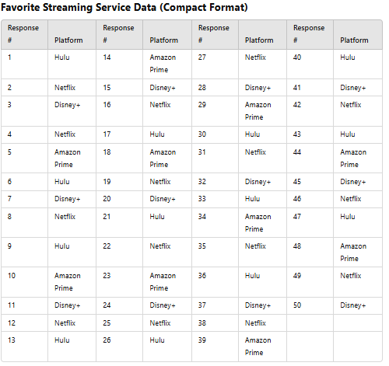
Question 1:
A survey was conducted among 50 individuals, asking them about their favorite streaming service. The responses were recorded as follows:

Slide 7
Question 1:
• What is the most preferred streaming service?
• What percentage of respondents chose Hulu?
• What is the total number of unique streaming services?

Slide 8
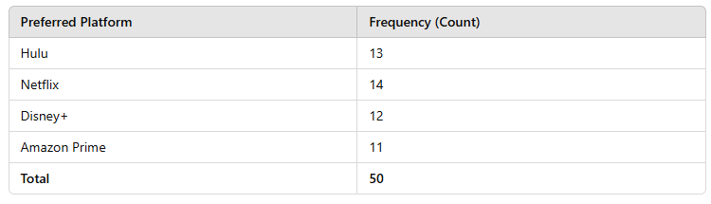
1. Frequency Table
This table shows the count of responses for each streaming service.

Slide 9
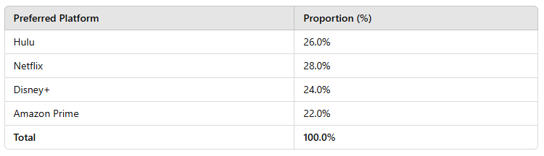
2. Proportion Table
This table shows the relative frequency (percentage) of each platform.

Slide 10
· What is the most preferred streaming service?
Netflix is the most preferred streaming service with 14 votes (28.0%).
· What percentage of respondents chose Hulu?
26.0% of respondents chose Hulu (13 out of 50 responses).
· What is the total number of unique streaming services?
There are 4 unique streaming services: Hulu, Netflix, Disney+, and Amazon Prime.

Slide 11

Central tendency
The indicators:
The sample (arithmetic) mean of n data values x1, . . . xn is
The sample median is the middle value after all of the values are put in an ordered list. For symmetric distributions, the mean and the median coincide
The mode is the most likely or frequently occurring value

Slide 12
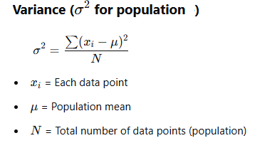
Spread Measures
The indicators:
the sample variance, for n observations x1 . . . xn, is the sum of the squared deviations, divided by n − 1

Slide 13
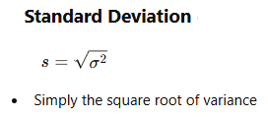
Spread Measures
The indicators:
the standard deviation s: the square root of the variance

Slide 14
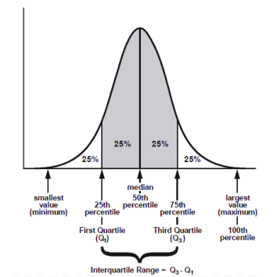
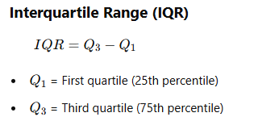
Spread Measures
The indicators:
interquartile range: The quartiles are the three values which divide the distribution into even fourths: 1/4 of the data fall below Q1, 1/2 fall below Q2, 3/4 fall below Q3.

Slide 15
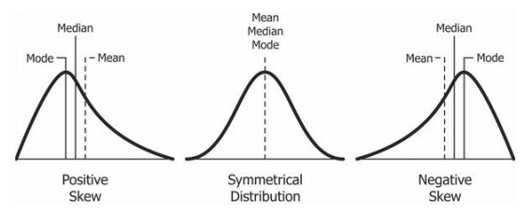
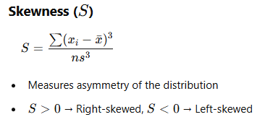
Shape of distribution
skewness is a measure of asymmetry

Slide 16
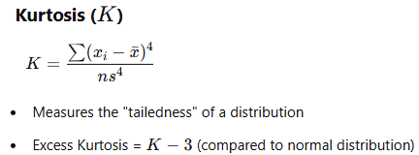
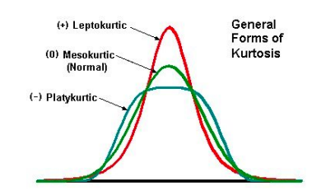
Shape of distribution
kurtosis is a measure of “peakedness” relative to a Gaussian shape.
High kurtosis (>3): More extreme values (heavy tails).
Low kurtosis (<3): Few extreme values (light tails).
Kurtosis = 3: Normal distribution.

Slide 17
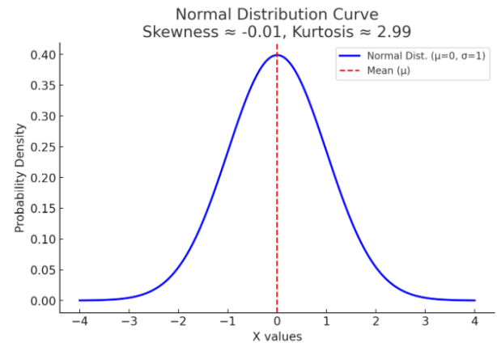
Shape of distribution
1. Normal Distribution (Skewness = 0, Kurtosis = 3)
Shape: Symmetrical, bell-shaped
Example: Heights of people, IQ scores
Interpretation:
No skewness (balanced left and right tails)
Kurtosis = 3 (mesokurtic, meaning it follows the normal distribution's tail behavior)
Graph: Looks like a classic bell curve.

Slide 18
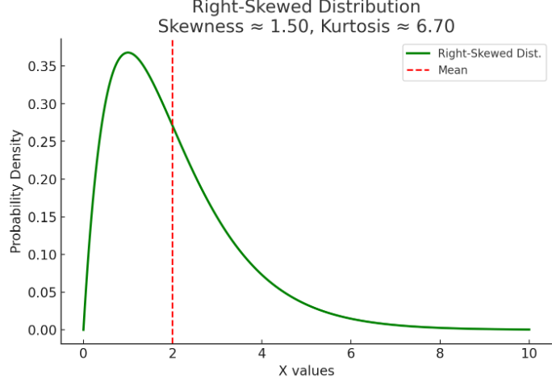
Shape of distribution
2. Right-Skewed Distribution (Positive Skewness, Kurtosis ≈ 3)
Shape: Longer right tail (majority of values are concentrated on the left)
Example: Income distribution, waiting times at a bus stop
Interpretation:
Skewness > 0 (right tail is stretched)
Kurtosis ≈ 3 (mesokurtic, similar to normal but shifted)
Graph: The peak is left-heavy, with a longer right tail.

Slide 19
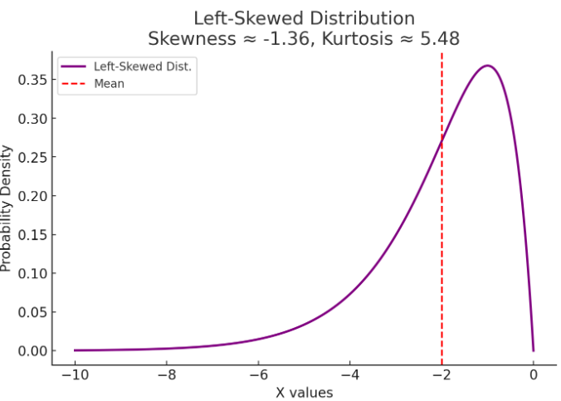
Shape of distribution
3. Left-Skewed Distribution (Negative Skewness, Kurtosis ≈ 3)
Shape: Longer left tail (majority of values on the right)
Example: Age at retirement, scores on an easy exam
Interpretation:
Skewness < 0 (left tail is stretched)
Kurtosis ≈ 3 (still mesokurtic)
Graph: The peak is right-heavy, with a longer left tail.

Slide 20
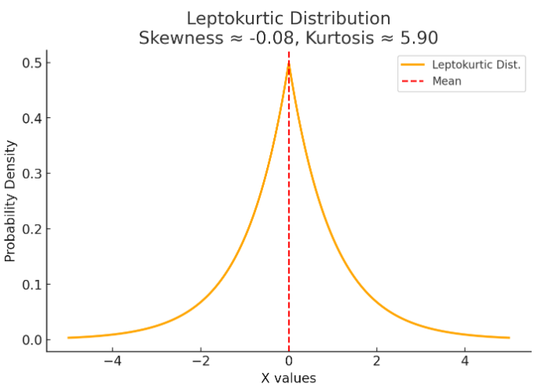
Shape of distribution
4. Leptokurtic Distribution (Skewness ≈ 0, Kurtosis > 3)
Shape: Very tall and sharp peak with heavy tails
Example: Stock market returns, rare but extreme events
Interpretation:
Skewness ≈ 0 (symmetrical)
Kurtosis > 3 (fat tails, meaning more extreme values than normal)
Graph: Very sharp peak and thick tails (more extreme outliers).

Slide 21
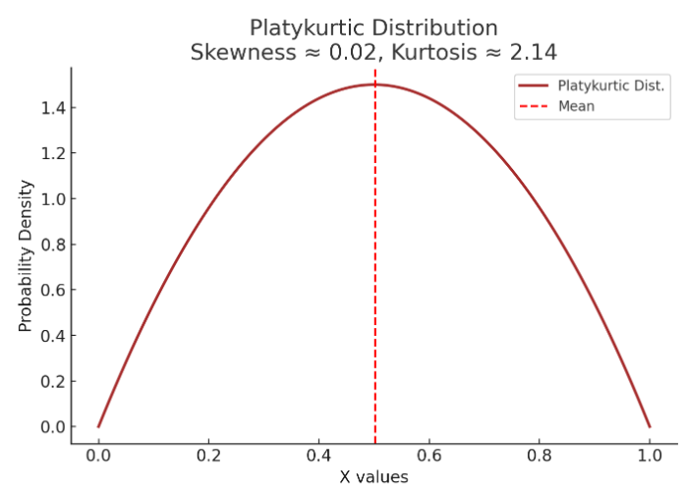
Shape of distribution
5. Platykurtic Distribution (Skewness ≈ 0, Kurtosis < 3)
Shape: Flatter peak with thin tails
Example: Uniform-like data, rolling a fair die
Interpretation:
Skewness ≈ 0 (symmetrical)
Kurtosis < 3 (light tails, meaning fewer outliers than normal)
Graph: Flat and spread-out distribution.

Slide 22
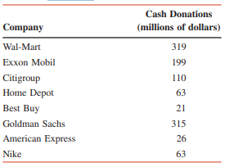
Question 2:
The table lists the total cash donations (rounded to millions of dollars) given by eight U.S. companies during the year 2010
Cash Donations in 2010 by Eight U.S. Companies

Slide 23
Question 2:
Compute
Measures of Central Tendency
Measures of Dispersion
Shape of Distribution
Cash Donations in 2010 by Eight U.S. Companies

Slide 24

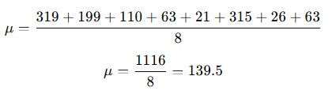
Measures of Central Tendency
Mean (𝜇)
The mean (average) is calculated as:
Where:
X is each value in the dataset
N is the total number of values
So, the mean donation is $139.5$ million.

Slide 25

Measures of Central Tendency
Median (M)
The median is the middle value when the data is arranged in ascending order.
Ordered data:
21,26,63,63,110,199,315,319
Since there are 8 values (even number), the median is the average of the 4th and 5th values:
So, the median donation is $86.5$ million.

Slide 26
Measures of Central Tendency
Mode
The mode is the most frequently occurring value.
From the ordered dataset:
21,26,63,63,110,199,315,319
The value 63 appears twice, making it the mode.
So, the mode donation is $63$ million.

Slide 27

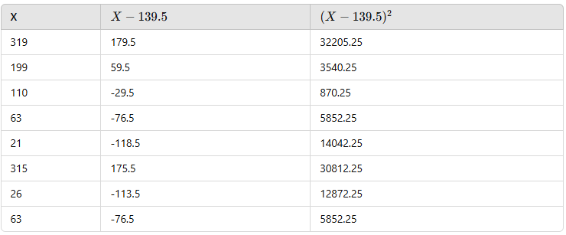
Measures of Dispersion
Variance (𝜎²)
Variance measures how much the values deviate from the mean. It is calculated as:
Step 1: Calculate Each Deviation from the Mean

Slide 28
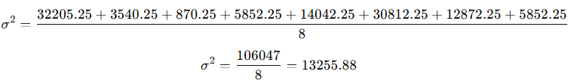
Measures of Dispersion
Variance (𝜎²)
Variance measures how much the values deviate from the mean. It is calculated as:
Step 2: Compute Variance
So, the variance is $13255.88 million.

Slide 29

Measures of Dispersion
Standard Deviation (𝜎)
The standard deviation is the square root of variance:
So, the standard deviation is $115.18 million

Slide 30

Measures of Dispersion
Interquartile Range (IQR)
IQR = Q3 - Q1
Step 1: Find Q1 (First Quartile)
Q1 is the median of the lower half:
21,26,63,63
The median of this subset is:

Slide 31

Measures of Dispersion
Step 2: Find Q3 (Third Quartile)
Q3 is the median of the upper half:
110,199,315,319
The median of this subset is:

Slide 32

Measures of Dispersion
Step 3: Compute IQR
So, the IQR is $212.5 million.

Slide 33

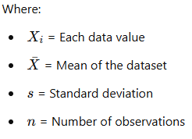
Shape of Distribution
Skewness:
Skewness measures the asymmetry of a distribution. The formula is:

Slide 34


Shape of Distribution
Skewness
Step 1: Compute the Mean (Xˉ\bar{X}Xˉ)
The mean is calculated as:

Slide 35

Shape of Distribution
Skewness
Step 2: Compute the Standard Deviation (sss)
Standard deviation formula:

Slide 36
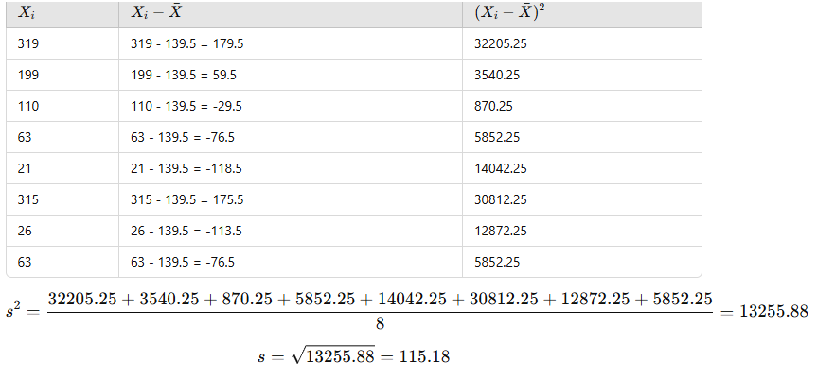
Shape of Distribution
Skewness

Slide 37

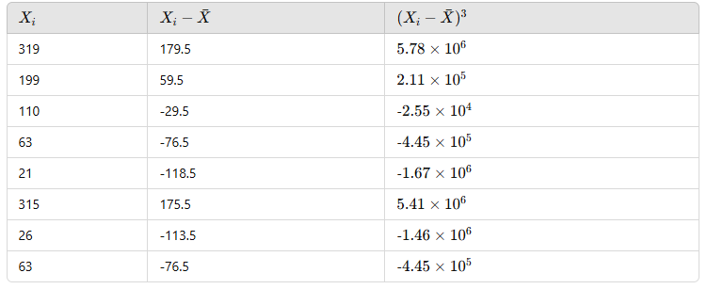
Shape of Distribution
Skewness
Step 3: Compute the Skewness Formula

Slide 38
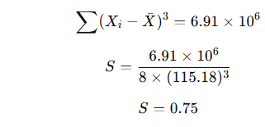
Shape of Distribution
Skewness
So, Skewness = 0.75, indicating a right-skewed distribution

Slide 39

Shape of Distribution
Kurtosis
Kurtosis measures the "tailedness" of a distribution. The formula is:

Slide 40
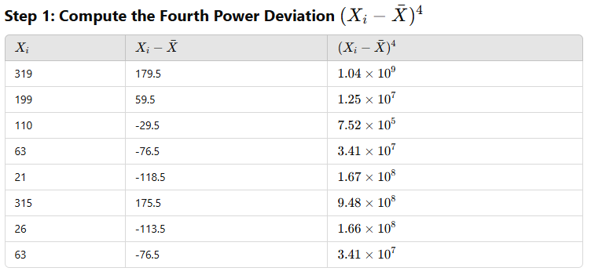
Shape of Distribution
Kurtosis

Slide 41
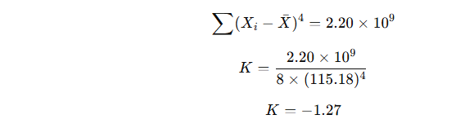
Shape of Distribution
Kurtosis
So, Kurtosis = -1.27, meaning the distribution is platykurtic (flatter than normal).

Slide 42
02.
Univariate Graphical EDA
provide a visual approach to understanding the distribution and characteristics of a single variable.

Slide 43
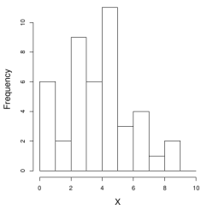
Histograms
(for categorical data): a barplot of the tabulation of the data. Each bar represents the frequency or proportion of cases for a range of values.

Slide 44
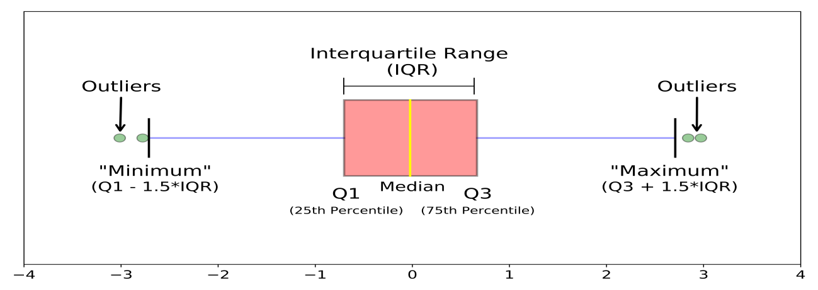
Boxplots
show extreme values, median and quartiles. You can easily figure out outliers. Show information about the central tendency, symmetry and skew, outliers; misleading about multimodality.

Slide 45
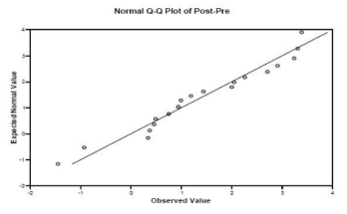
Quantile-normal plots
used to compare the distribution of a dataset against a theoretical normal distribution.

Slide 46
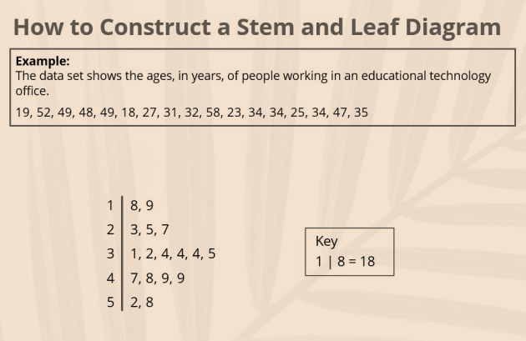
Stem-and-Leaf Plots
displaying quantitative data while preserving the original data values, making them a useful alternative to histograms.

Slide 47
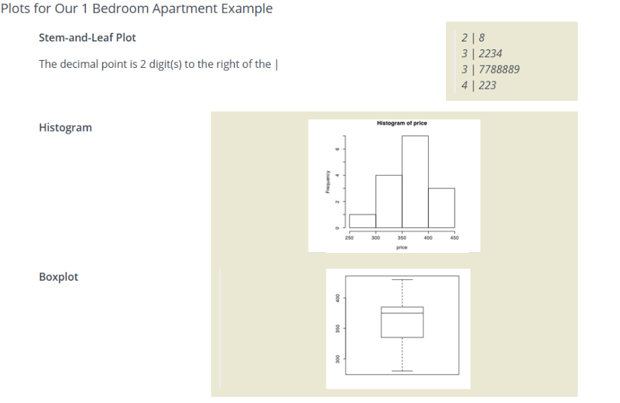
Question 3
Given the plots:
What is the shape of the distribution?
Any outliers?
Is the median larger or smaller than the mean?

Slide 48
Question 3
What is the shape of the distribution?
The histogram appears to be left-skewed (negatively skewed) because the bins extend further towards the left (longer tail). The mean is therefore less than the median.
Any outliers?
The boxplot suggests there are no outliers. If any individual points appear beyond the whiskers, they would be considered outliers. Since we don't see specific outlier markers in the image, it may indicate either no extreme outliers or mild ones close to the whiskers.
Is the median larger or smaller than the mean?
In a left-skewed distribution, the mean is typically smaller than the median because extreme low values pull the mean downwards. Given the skewness in the histogram and boxplot, the median is likely larger than the mean.

Slide 49
03.
Multivariate nongraphical EDA
show the relationship between
two or more variables.

Slide 50
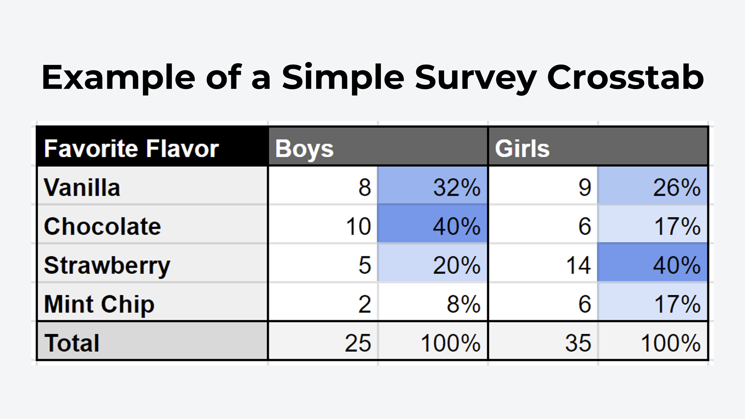
Cross-Tabulation
statistical technique used to analyze the relationships between two categorical variables by organizing the data into a matrix format.

Slide 51
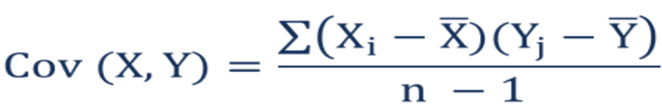
Covariance
measures the degree to which two variables change together.
Positive covariance indicates that as one variable increases, the other tends to increase.
Negative covariance indicates that as one variable increases, the other tends to decrease.
Where:
Xi – the values of the X-variable
Yj – the values of the Y-variable
X̄ – the mean (average) of the X-variable
Ȳ – the mean (average) of the Y-variable
n – the number of data points

Slide 52
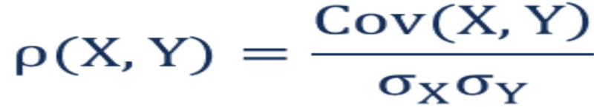
Correlation
quantifies the strength and direction of the relationship between two variables
Correlation coefficients range from -1 (perfect negative correlation) to +1 (perfect positive correlation).
A correlation of 0 indicates no linear relationship between the variables.
Where:
ρ(X,Y) – the correlation between the variables X and Y
Cov(X,Y) – the covariance between the variables X and Y
σX – the standard deviation of the X-variable
σY – the standard deviation of the Y-variable

Slide 53
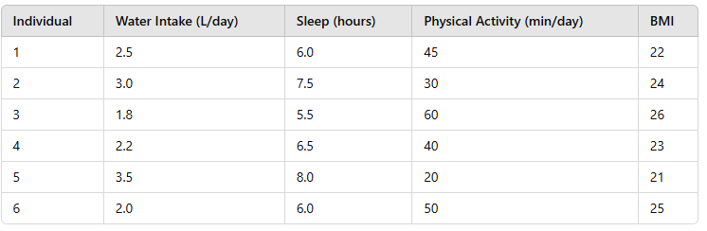
Question 4
The following table represents data collected from six individuals on their daily water intake (liters), sleep duration (hours), physical activity (minutes per day), and BMI (Body Mass Index).
1. Compute the Covariance between Water Intake and BMI.
2. Compute the Correlation between Sleep and BMI.

Slide 54
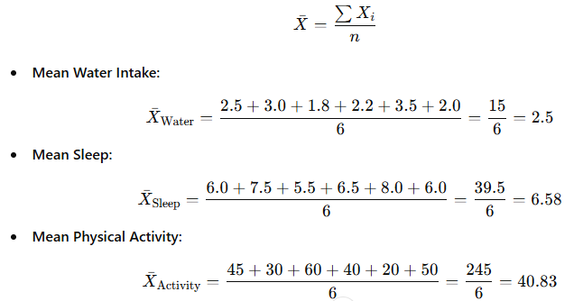

Question 4
Calculate the Mean for Each Variable.

Slide 55
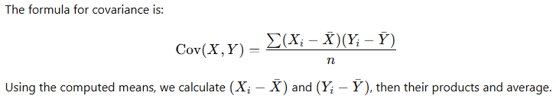
Question 4
1. Compute the Covariance between Water Intake and BMI.

Slide 56
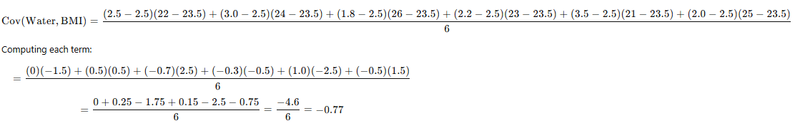
Question 4
1. Compute the Covariance between Water Intake and BMI.
Interpretation: Since the covariance is negative, it suggests that as water intake increases, BMI tends to decrease.

Slide 57
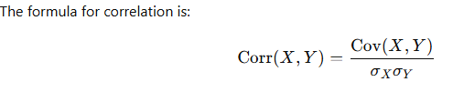
Question 4
2. Compute the Correlation between Sleep and BMI.

Slide 58
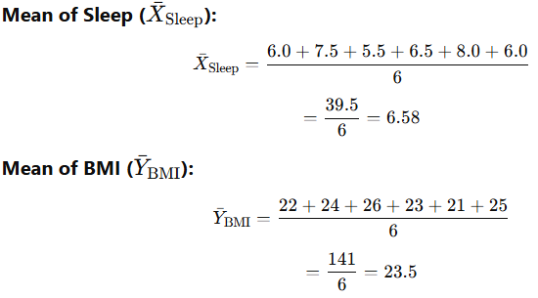
Question 4
2. Compute the Correlation between Sleep and BMI.
Compute the Mean of Sleep and BMI

Slide 59
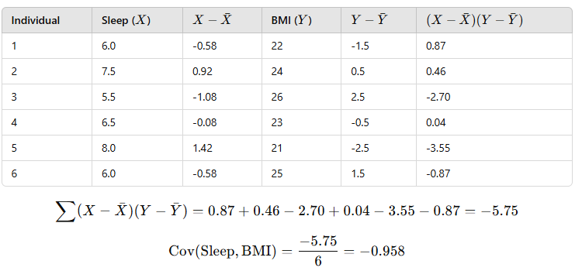
Question 4
3. Compute the Correlation between Sleep and BMI.
Compute Covariance Between Sleep and BMI

Slide 60
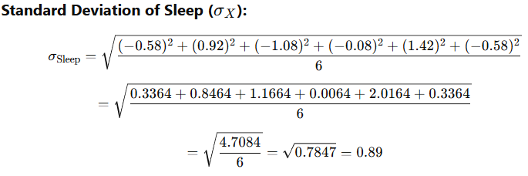
Question 4
2. Compute the Correlation between Sleep and BMI.
Compute the Standard Deviations

Slide 61
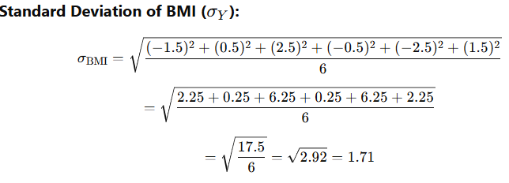
Question 4
2. Compute the Correlation between Sleep and BMI.
Compute the Standard Deviations

Slide 62
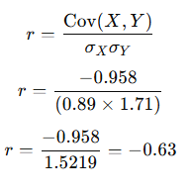
Question 4
2. Compute the Correlation between Sleep and BMI.
Interpretation
moderate negative correlation between Sleep and BMI.
This suggests that as sleep duration increases, BMI tends to decrease.
Since 𝑟 is closer to -1 than 0, the relationship is moderately strong.

Slide 63
04.
Multivariate Graphical EDA
essential for visualizing relationships among multiple variables.

Slide 64
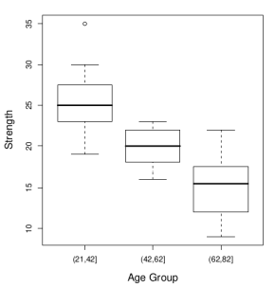
Side-by-side boxplots
for examining the relationship between a categorical variable and a quantitative variable, as well as the distribution of the quantitative variable at each level of the categorical variable

Slide 65
Scatter plots
graphical representations that display the relationship between two quantitative variables

Slide 66
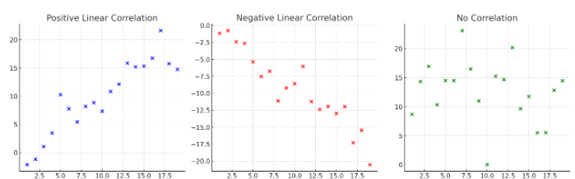
Scatter plots
1. Positive Linear Correlation
Pattern: Data points form an upward sloping trend. Interpretation: As one variable increases, the other also increases. Example: More study hours → Higher exam scores.

Slide 67
Scatter plots
2. Negative Linear Correlation
Pattern: Data points form a downward sloping trend. Interpretation: As one variable increases, the other decreases. Example: More exercise → Lower blood pressure.

Slide 68
Scatter plots
3. No Correlation
Pattern: Data points are randomly scattered. Interpretation: No visible relationship between the variables. Example: Shoe size vs. intelligence.

Slide 69
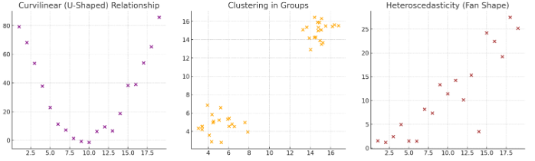
Scatter plots
4. Curvilinear (U-Shaped) Relationship
Pattern: Data follows a curve (e.g., U-shape or inverted U-shape). Interpretation: The relationship changes direction at a certain point. Example: Stress vs. Performance (moderate stress improves performance, but excessive stress reduces it).

Slide 70
Scatter plots
5. Clustering in Groups
Pattern: Data points form distinct clusters. Interpretation: Indicates sub-groups within the data. Example: Customer segmentation in marketing (e.g., budget vs. premium buyers).

Slide 71
Scatter plots
6. Heteroscedasticity (Fan Shape)
Pattern: Spread of points increases as values increase.
Interpretation: Variance is not constant, which can be problematic in regression.
Example: Income vs. spending behavior—higher incomes show more variation in spending.

Slide 72
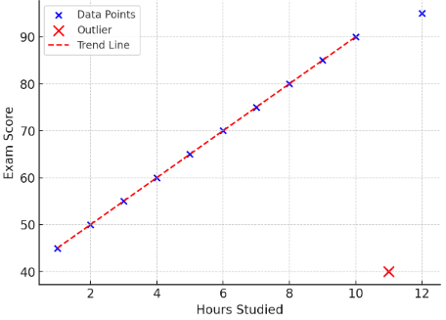
Question 5
A researcher collected data on the number of hours students studied for an exam and their corresponding scores. The scatter plot below displays this data.

Slide 73
Question 5
(a) Identify the pattern in the graph. Does it show a positive, negative, or no correlation?
The pattern in the graph shows a positive correlation. As study hours increase, exam scores tend to increase.

Slide 74
Question 5
(b) Based on the trend, estimate the expected score for a student who studied for 7 hours (interpolation).
a student who studied for 7 hours is expected to score around 75.

Slide 75
Question 5
(c) There is an outlier at (11, 40). How does this outlier affect the relationship between study hours and exam scores?
The outlier at (11, 40) does not follow the trend. It lowers the overall correlation and might skew the regression line if used in a predictive model.

Slide 76
Question 5
(d) What type of trend does the red dashed line represent?
The red dashed line represents a linear trend line, showing the general direction of the data.

